Slide 1
Change log
September 2021
Updated copyright footer on all slides

Slide 2
Introduction to containers and Docker
Containers Immersion Day: Module 1
Notes:
SAY: Welcome to module 1 of the AWS Containers Immersion Day. An Introduction to Containers and Docker.
// Script for training videos.
SAY: Hello, and welcome to the AWS Containers Immersion Day training series.
SAY: The goal of this video is to show you how to deliver the presentation material for module 1, Introduction to containers.

Slide 3
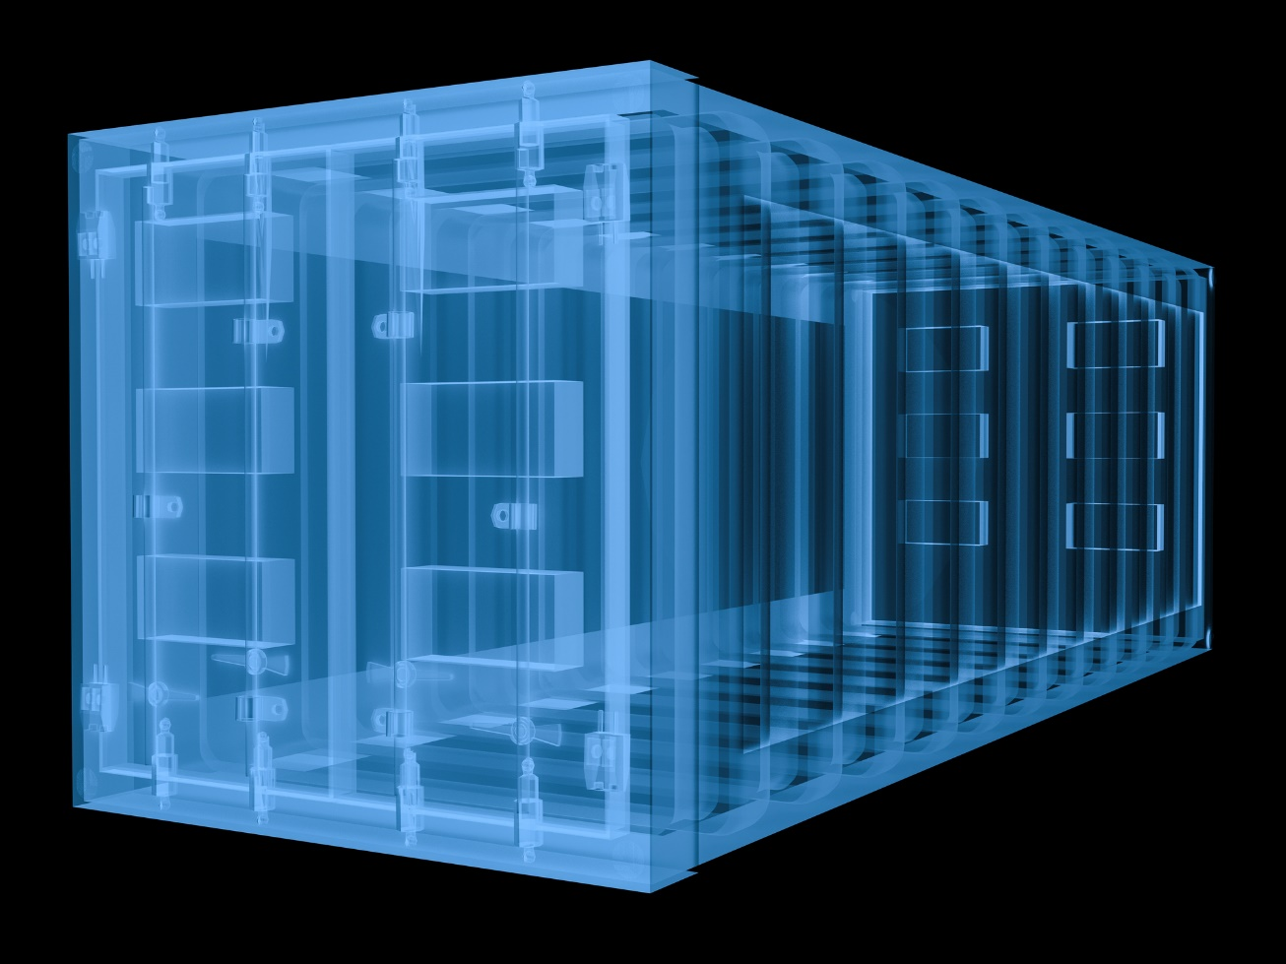
First things first…
What are containers and why are customers using them?
Notes:
SAY: What are containers and why are customers using them?
ASK: How many of you out there developers?
ASK: How many of you would consider your self system administrators?
SAY: Containers really are an evolution of virtualization technology - virtualized Hardware, virtualized machines are what we're used to, and we have been used to for many years. There are many vendors that provide this kind of virtualization, including Amazon Web Services with EC2.
SAY: With a virtual machine you have an operating system which is virtualized and you're running an application and the associated binaries and libraries that are required for that application within a virtual environment.
SAY: Containers on the other hand are a little bit further up the stack. Instead of virtualizing the operating system and hardware you are instead virtualizing OS-level components. The operating system makes processes believe that they are running in their own environment. They cannot see the other processes running on that operating system and have access to their own virtualized resources, including the file system tree.
SAY: The concept of process isolation is not new has and have been used for a number of years, with technologies like the unix CHROOT command, Solaris Zones and FreeBSD jails. The step change in mainstream adoption of containers came about in around 2013, with the introduction of a standard set of tools and packaging format that enabled the quick and easy sharing and distribution of ”containers”.
SAY: So, why are customers using them?
<CLICK>

Slide 4
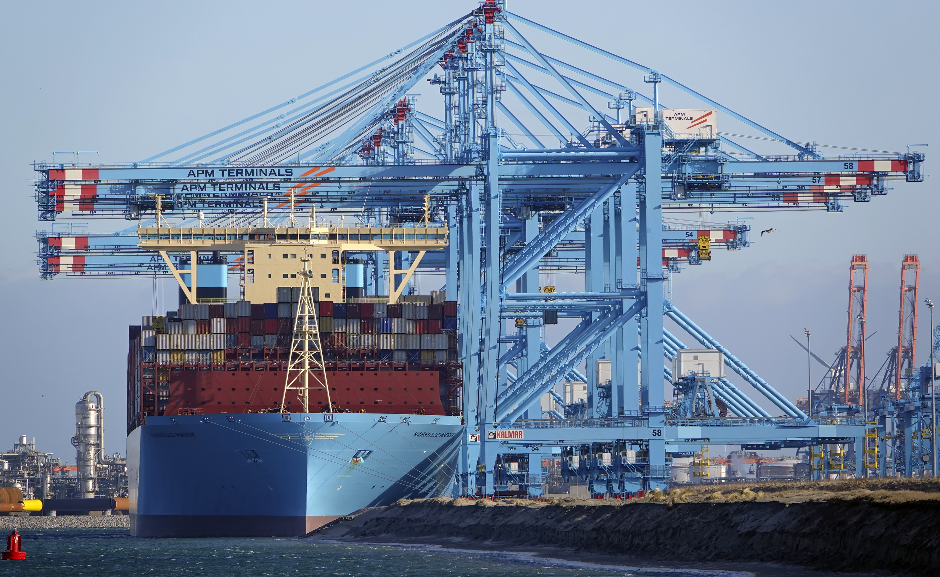

Why are companies adopting containers?
© 2021, Amazon Web Services, Inc. or its Affiliates.
Photo & Licence
Notes:
SAY: Why are companies adopting containers?

Slide 5
Why are companies adopting containers?
Accelerate software development
© 2021, Amazon Web Services, Inc. or its Affiliates.
Photo & Licence
Notes:
Why are companies adopting containers?
Accelerate software development
Modern applications are shifting to cloud native and microservices architectures and containers are a perfect way to encapsulate these pieces into portable units.
Development methodologies are changing with developers shifting to agile methods, DevOps and leveraging continuous integration/continuous deployment systems (CI/CD). Containers, being lightweight and portable, make great vessels to wrap code with in order to push them through these new software pipelines.

Slide 6
Why are companies adopting containers?
Accelerate software development
Build modern applications
© 2021, Amazon Web Services, Inc. or its Affiliates.
Photo & Licence
Notes:
Why are companies adopting containers?
Build modern applications
Containers can also be used for existing applications without any refactoring. This allows the application to be more portable for migration to the public cloud and can also retrofit the application into newer developer workflows and software pipelines. However, refactoring the application will bring further benefits and customers often will first containerize, then refactor parts of the application or build moderns extensions to the application over time.

Slide 7
Why are companies adopting containers?
Accelerate software development
Build modern applications
Automate operations at web scale
© 2021, Amazon Web Services, Inc. or its Affiliates.
Photo & Licence
Notes:
Why are companies adopting containers?
Automated operations at web scale
Container orchestration and management systems are designed to deploy and manage distributed, cloud native applications. In order to this at any scale, full automation is a core.

Slide 8
Notes:
SAY: In a nutshell the modern container is a standard unit of deployment that packages up all of your code and all of its dependencies so that you can deploy your
application quickly, and have it run reliably across a number of different compute environments.
SAY: That can be a challenge if you don't know necessarily where your application is going to run, because are a lot of variables to consider. Containers can help ease that challenge.
SAY: Lets take a look at how that typically plays out …

Slide 9




Application environment components
Runtime Engine
Code
Dependencies
Configuration
Notes:
SAY: Lets take a moment to think about what an application, YOUR application, is made up of …
All applications need some kind of runtime , JVM, .NET, node.JS
Then you need your application code.
Then you’ve got your dependencies and configurations (software, packages libraries that your code needs to run).
Configuration items, environment differences, connection strings, environment variables etc.

Slide 10


Different environments
Local Laptop
Staging / QA
Production
On-Prem
Notes:
SAY: Lets now think about what it looks like to deploy this application, first in a local development environment and then in to test, staging and production environments …

Slide 11
It worked on my machine, why not in prod?
v6.0.0
v7.0.0
v4.0.0
v7.0.0
Local Laptop
Staging / QA
Production
On-Prem
Notes:
SAY: Your local development environment, will typically have everything installed that you need to develop, test, build and run your application.
SAY: But there are not guarantees that the same's things will exist in your staging or production environments. For example, versions of runtime or packages may be different
SAY: The more environments, this more challenging this become. Dependency drift is a problem.
[ASK] Does this sound familiar?
[ASK] Can anywhere share a story about a time where they ran in to this problem? What happened? What was the result?
SAY: Lots of engineering cycles can be spent troubleshooting these kinds of problems.
SAY: This can lead to increased rate of failure related to changes and software deployments.

Slide 12

Containers to the rescue
Runtime Engine
Dependencies
Code
Notes:
SAY: But when we incorporate containers in to our tool chain, things look a bit different. All of the things we take for granted in our build environments: runtimes, code, dependencies, are all packaged up in the same, portable unit of deployment.

Slide 13
Notes:
SAY: There is no better word to encapsulate all of the benefits Containers bring, than “Container”
SAY: Think about the shipping container - its a standard thing that fundamentally transformed logistics. Before the shipping container, there were no standards for how things got moved around. Everything was shipped in a slightly different way, with companies haphazardly following any of the very limit standards that did exist. Shipping anything was slow, expensive and generally inefficient.
SAY: Following the introduction of the shipping container back in the1950s global shipping changed forever. Governments, companies and docks converged on the standards for designing and building ships, cranes, trucks and trains. And I’m sure you’ll everything now runs a lot more efficiently.
[ASK] What comes to mind when you think about Containers? (People often say Docker).
SAY: You might have heard a lot about Docker. Whilst synonymous with containers, Docker is one of a number of container runtimes in the eco-system. Other examples include ContainerD.
<CLICK>

Slide 14

What is Docker?
Lightweight container virtualization platform.
Ecosystem of tools to manage and deploy your applications
Licensed under the Apache 2.0 license.
Built by Docker, Inc.
Moby: Open source project
Notes:
SAY: Docker is a software platform that allows you to build, test, and deploy applications quickly
SAY: Docker is an open source project which first came to the mainstream in 2013. It was born out of a company called dotCloud. Dot cloud used this tech to build a PaaS offering. They quickly realized that the tech that they had developed had much broader applications, and Docker was born.
SAY: Remember how I talked about “original” containers being primarily geared towards process isolation and that in 2013, things changes with the introduction of a standard packaging format? Enter Docker. Dockers innovation wasn’t in the space of OS virtualization. Those things had been done years before - Dockers innovation was in the space of packaging those applications / containers and providing a really smoother developer experience through their ecosystem of tools. Making containers an accessible to the masses and key part of every developers tool chest.
SAY: If you’d like to learn more about Docker, check out a talk from the dotScaler conference in 2013 by one of the co-creators of Docker, Solomon Hykes.
Ref: https://www.youtube.com/watch?v=3N3n9FzebAA

Slide 15
Containers vs VMs
Containers
Using Linux primitives for isolation
Share Linux Kernel
Fast starts, minimal overhead
Flexible isolation
Virtual Machines
Virtualisation or emulate hardware components
Completely separate kernels (maybe not Linux)
Slower starts, must boot kernel and set-up hardware.
Container
Container
VM Guest
VM Guest
Linux Kernel
cgroups
namespaces
---
Virt Hardware
Virt Hardware
Linux Kernel
KVM
Hardware
Hardware
Notes:
SAY: Before we go any further, lets stop and answer a question that you’ve probably all been wondering. What is the difference between a virtual machine and a container?
Containers share a kernel, all components are built in to kernel
This makes containers fast to start and, when compared to VMs, they generally have lower overhead.
VMs have a more defined isolation boundary – that is to say that containers do share some kernel interfaces
VMs virtualise or emulate hardware
You need to run a full OS (and Kernel) in order to use a VM.
Each VM handles boot processes including device initialisation
VMs typically require more overhead than containers

Slide 16

What are containers made from?
Linux container primitives …
… unshare
… /sys/fs/cgroup/memory
… capsh
… Secomp
… Linux security modules
… Union file systems
Notes:
SAY: I talked about kernel components in the previous slide and I would like to elaborate a bit more on what components exactly those components are, and what they do. Containers a made up of the following:
Namespaces: provide visibility controls and isolation for things like network and filesystem
Control Groups: limit resources for a given containers, like CPU, memory or disk IO
Capabilities: provide more fine grained permissions than just root or non-root user
SecComp: enables / disables certain syscalls
Linux security modules: like app armour and selinux provide access controls to resources like files.
A union file system: is a file system that amalgamates a collection of different file systems and directories (called branches) into a single logical file system – this is what image layers work with.

Slide 17
Container images
Read only image that is used as a template to launch a container.
Start from base images that have your dependencies, add your custom code.
Dockerfile for easy, reproducible builds.
Writable
add NGINX
Container
add nodejs
Image
References
parent
image
Ubuntu
Image
Base image
bootfs
kernel
Notes:
SAY: The container image is the building block of a container.
SAY: Each container is an image is a composite of things with a readable/writeable layer on top of a bunch of read-only layers.
SAY: This is similar to how a git repo works. Each time your make a commit, it is added to the a long list of commit - essentially an immutable change log
SAY: The container image represents a sum of all of those commits. Each commit you make is a new layer
SAY: New instances of a container are spawned from a container image. Here you can see that I’ve started with an ubuntu base image, I’ve then added node, followed by NGINX.
SAY: When we use tools like the Docker CLI, these layers (also called intermediate images) are generated when the commands in a “Dockerfile” (an set of steps) are executed during the image build process.

Slide 18
Four environments, same container
Local Laptop
Staging / QA
Production
On-Prem
Notes:
SAY: Armed with our container image …
SAY: Because all of the runtimes, code, dependencies and configurations are encapsulated within the container image, your application will run across multiple different environments. Reducing the time it takes to move through the various stages of development.
SAY: Now, we can run the same thing anywhere
[ASK] Do these concepts, build once, run anywhere, sound familiar to anyone?
SAY: Java was marketing an approach like this back in the day - containers are helping with that.

Slide 19



Container benefits
Runs reliably everywhere
Run different apps simultaneously
Better resource utilization
Notes:
SAY: Lets take a moment to recap on the benefits of containers as a deployment mechanisms for software.
Because everything you need to run your application is encapsulated within the container, your applications will run reliable across local, non-prod and production environments.
Containers provide process isolation and isolation of dependencies and runtimes, meaning you can run different apps and different versions of the same app simultaneously on the same operating systems.
This ultimately leads to better utilization resources.

Slide 20
Demo of launching a container
Notes:
[RUN] a demo of launching a container using the Docker CLI.

Slide 21



Managing one containers is pretty easy
Notes:
SAY: You’ve seen from the demo I just gave that running a single container is pretty easy ….

Slide 22
Managing many containers is hard
Notes:
SAY: But how do you go about managing tens, hundreds or even thousands on containers running across a distributed fleet of infrastructure?
SAY: Great question, and that is something we are going talk about in the next module when we start exploring container orchestration.

Slide 23
AWS container services landscape
Management
Deployment, Scheduling, Scaling & Management of containerized applications
Amazon Elastic
Container Service
Amazon Elastic
Container Service for Kubernetes
Hosting
Where the containers run
Amazon EC2
AWS Fargate
Image Registry
Container Image Repository
Amazon Elastic
Container Registry
Notes:
Conclude this module with a quick overview of the AWS Container Service Landscape.
SAY: Having spoke about why organisations are using containers, what containers are and having see a demonstration of containers, we’re all here today to learn about how you ruin containers on AWS.
SAY: The current AWS container services landscape covers a broad set of products.
SAY: At the orchestration layer we’ve Amazon ECS and Amazon EKS. EKS makes it easy to deploy, manage, and scale containerized applications using Kubernetes on AWS.
SAY: You can currently run your containers on ECS using either the EC2 launch type – where get to manage the the underlying instances on which your containers are running - or you can choose to run your containers in a serverless manner with the AWS Fargate launch type.
SAY: Finally, we provide a registry services, Amazon ECR, where you can store your container images.

Slide 24
Questions?
Introduction to containers and Docker
Notes:
SAY: Let’s stop here and I’d like to pause for questions before we move on to module 2, introduction to Amazon Elastic Container Registry.

